Slide 1
Distributed Representations of Words and Phrases and their Compositionality
Presented by
megha eldho
sharik anwar zahir hussain
krishnapriya krishnan santhadevi
Dheenadayalan tamilarasan muthuselvi

Slide 2
The paper discusses
Skip-gram model
Authors aimed at enhancing the quality of the vector representations and speeding up the training process.
Introducing "Negative Sampling" as an alternative to the hierarchical softmax.
Addresses the significant limitation of word representations.

Slide 3
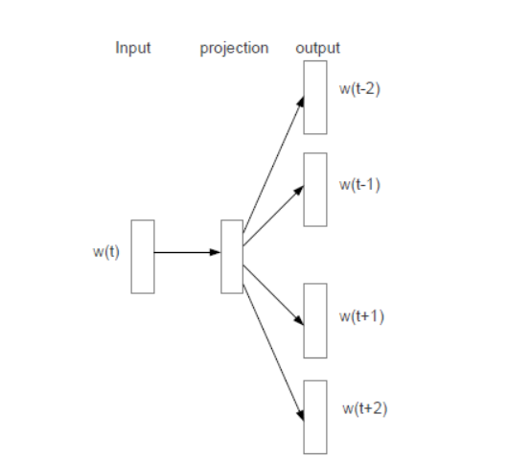
Skip Gram Model
The Skip-gram model's primary goal is to predict the context words (words that appear in the neighborhood) of a given target word.
The input to the model is the one-hot encoded vector of the target word, and the output is a probability distribution over all words in the vocabulary.

Slide 4
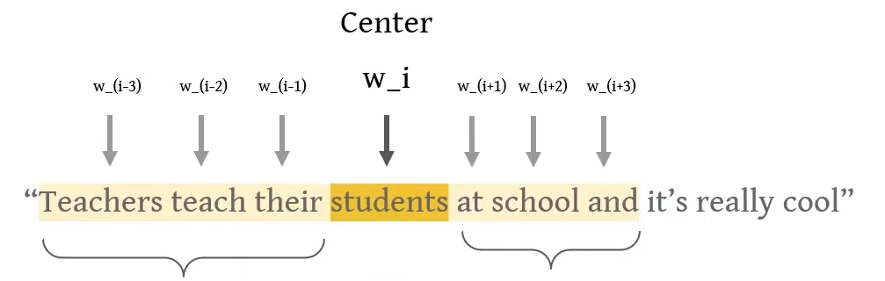
Goal : Calculate the probabiliity of each context word occuring given the center word.
Example :
If “Student” is present in the corpus, there should be a higher probability that “School” is in the same context as opposed to “dog” (which has less relevance).

Slide 5
Hierarchical Softmax
The primary advantage of hierarchical softmax is that it significantly reduces the computational complexity.
Instead of evaluating all W output nodes, it only requires the evaluation of approximately log₂(W) nodes in the binary tree.
i.e) It organizes the output classes into a tree-like structure, where each word is represented as a path from the root of the tree to the leaf node corresponding to that word.

Slide 6
Selection of Tree
The choice of the tree structure in hierarchical softmax indeed has a significant impact on the performance of the model.
The structure of the tree influences both the training time and the resulting model accuracy.
In this paper, they used binary Huffman tree.
The more frequent words are placed closer to the root of the tree, and less frequent words are positioned deeper in the tree.
It assigns short binary codes to frequent words.

Slide 7
Negative Sampling
NCE (Noise Contrastive Estimation) posits that a good model should be able to differentiate data from noise by means of logistic regression.
The hinge loss encourages the model to assign higher scores to real data (correct words) than to noise data (incorrect words).
Negative sampling involves selecting a small number of negative (noise) samples and calculating the loss based on the difference between the probability of the actual data and the probability of the negative samples.

Slide 8
Negative Sampling and NCE
The key difference between Negative Sampling and NCE is the requirement for numerical probabilities of the noise distribution.
Negative Sampling uses only samples, while NCE needs both samples and probabilities.
Negative Sampling is preferred by the authors because they serve the desired goals effectively without the need for exact probability estimation.

Slide 9
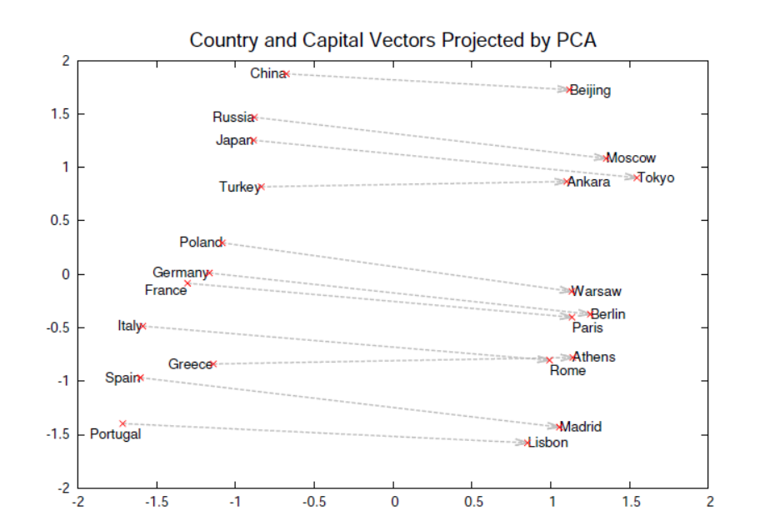
A two-dimensional PCA projection of 1000-dimensional Skip-gram vectors of countries and their capital cities is a visual representation that demonstrates the ability of the Skip-gram model to organize and learn relationships between words or concepts implicitly.

Slide 10
Subsampling of Frequent Words
In large corpora, extremely common words like "in," "the," and "a" can occur hundreds of millions of times and these words are encountered so frequently that they overshadow the less common and more semantically meaningful words.
By subsampling, the model pays less attention to common words during training.
Focuses more on less common, more interesting words.
Benefits :
Speed
Quality

Slide 11
Key Limitation
Inability to understand idiomatic phrase.
To address this, paper introduces the concept of Phrase Vectors.
Example :
Kick the bucket means to die.
Separate meaning doesn’t have anything to do with death.
“Kick”, “the”, “bucket” : Each has a different code and the model can’t catch the meaning of the idiom that it means to die.

Slide 12
Paper Solution :
Creating special codes for whole phrases.
Phrase vectors capture unique meaning.
Model starts to look group of words as a single unit.
Authors talks about moving
from Model that understands single words
to model that understands group of words.

Slide 13
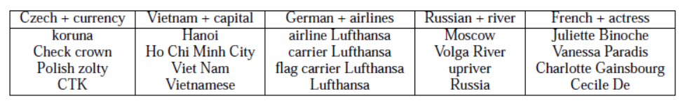
Another property of Skip Gram
Vector addition for meaningful results.
Skip-gram representations exhibit another type of linear structure, allowing for meaningful combination of words by performing element-wise addition of their vector representations.
It enables the model to create composite representations of words and phrases.

Slide 14
If "Volga River" frequently appears in the same sentence with the words "Russian" and "river," the sum of the vector representations of "Russian" and "river" will result in a feature vector that is close to the vector of "Volga River."
This demonstrates how vector addition can capture meaningful associations and combinations of words.
Skip-gram model's word and phrase representations exhibit linear structures that allows meaningful combination of words using simple vector addition.

Slide 15
Conclusion
For precise analogical reasoning, they present a method for training word and phrase representations using the Skip-gram model.
Efficient model architecture enables training on much larger datasets, improving the quality of word and phrase representations, especially for rare words.
Introduces a simple yet effective training method called Negative sampling, which produces accurate representations for frequent words.
They demonstrate that word vectors can be meaningfully combined using vector addition, providing a straightforward approach to handle longer text pieces.
The work advances the field of word and phrase representations, offering practical solutions for training on large datasets, optimizing hyperparameters, and providing open-source tools for further research and applications.

